Slide 1

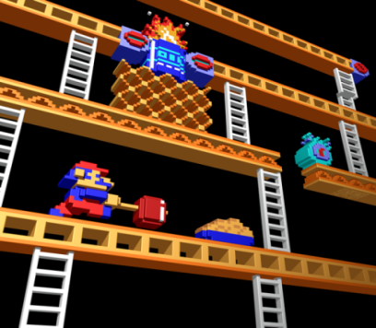

Problem Gaming/Excessive Internet Use
Stephanie Campoli– Outreach Counsellor -ASYR

Slide 2
Quick Facts about Gaming in Canada
58% of Canadians are gamers (46%female, 54%male)
31 years old is the age of the average Canadian Gamer
In 2010, there were 2 times more reported gamers than in 1998
Canadians spend 2 hours and 20 minutes/day playing games (2010)
Sources: ESA (2013), Essential Facts About Video Gaming in Canada; Statistics Canada
(2010), “General Social Survey: Time Use,” http://bit.ly/oFcBvq.

Slide 3
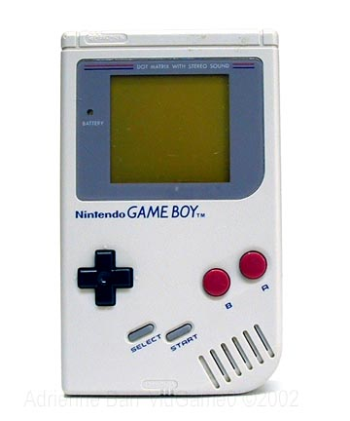
Quick Facts about Gaming in Canada
About 105 600 (10.3%) of Ontario students (grades 7-12) have a video gaming problem. Of these, 88 400 are males and 17 200 are females. The number of students in ontario with a video gaming problem is equivalent to about 6 Air Canada Centres filled to capacity at a Toronto Maple Leafs Game!

Slide 4
The average smart phone user
The average user reaches for their phone at 7:31am
These users check personal emails and Facebook before they get out of bed
The average person picks up their phones more than 1,500 times each week (over 200 times per day)
Average owners use their phone for three hours and sixteen minutes a day
Source: http://www.dailymail.co.uk/sciencetech/article-2783677/How-YOU-look-phone-The-average-user-picks-device-1-500-times-day.html#ixzz3UeNtfm5l

Slide 5
Internet Gaming
Platform games (Super Mario Brothers)
Sports games
First Person Shooter (Call of Duty)
Role Play Games (World of War craft)
Fighting games
Simulation games ( The Sims)
Puzzle Games (Tetris, Candy Crush)
Combination /Hybrid Games
Notes:
Some people use gaming as a source of income (ie: people create avatars for role play games and sell them on ebay)
Internet games generate huge revenues – in app purchases (Candy Crush generated 1.8 billion dollars last year)
Internet games are strategically designed in such a way that they require excessive amounts of time (and sometimes money) to be put in in order to “win” or advance to new levels
Smart phone games – send push notifications requiring a player to take action at all hours of the day and night
Many games targeted at youth have the same features (Webkins)
Gambling features within games (Slot Machines)

Slide 6
“Internet Gaming disorder”
Most people use the internet in ways that enhance their lives. (connecting with family, school, work, entertainment and shopping)
It can become problematic when it interferes with one’s ability meet expectations, maintain relationships, attend work/school etc.

Slide 7

IGD as a catch-all
Social networking (Twiter, Facebook, instagram)
Digital entertainment media (Streaming, YouTube)
Blogging and researching
Playing Online Games

Slide 8
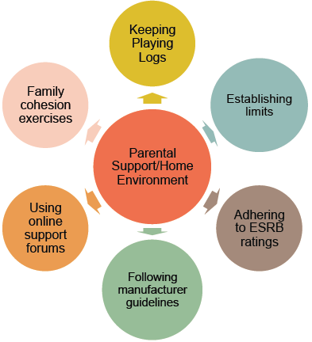
Tips for Parents
Notes:
CAMH pg forum, 2013

Slide 9
Tips for Healthy Gaming/Internet Use
Priorities (e.g; homework before gaming)
Turn off the computer or smart phone at a certain time each night
Set a limit on daily play
Keep tech devices away from your bedroom at night
Be aware of things that might trigger you
Don’t eat in front of your device
Have “tech free challenge days”
Play games that have less “addictive” qualities
Pay attention to time and what you do online
Listen to loved ones who may recognize the problem first
Maintain a log of daily video game/tech use
Avoid using gaming/tech use as a coping tool

Slide 10
Behavioural Addiction vs. Substance Abuse Similarities
Coping mechanism
Progression
Negatively impacts mood e.g. depression,mood swings
Chasing -high/win/rewards/levels
Preoccupation
Use of rituals
Loss of time-blackouts/brownouts e.g. lose track of time, dissociation

Slide 11
Behavioural Addiction vs. Substance Abuse Differences
Gamblers/gamers are not impaired
Physical Dependence
Gamblers/gamers can not overdose
Gambling / IGA can be more hidden
Less stigma
Online activities needed for many areas of life

